Slide 1

Power of Visual communication and storytelling in Software Engineering
Vaishnavi V

Slide 2


Disclaimer

Slide 3
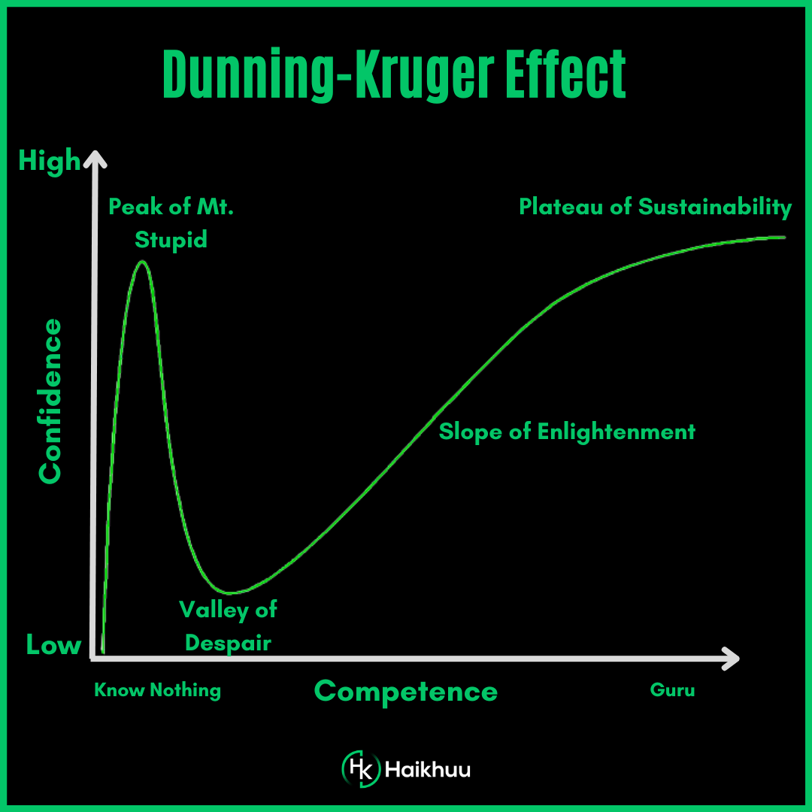
Dunning-Kruger effect

Slide 4
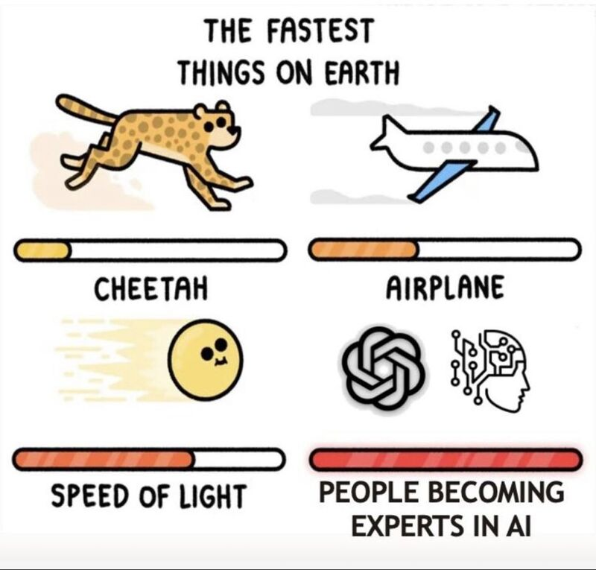
Not an expert!
Notes:
We're now witnessing the Dunning-Kruger effect in action and scale never seen before 😅
Remember - AI won't take your job but people who are "experts" in AI will 😉

Slide 5
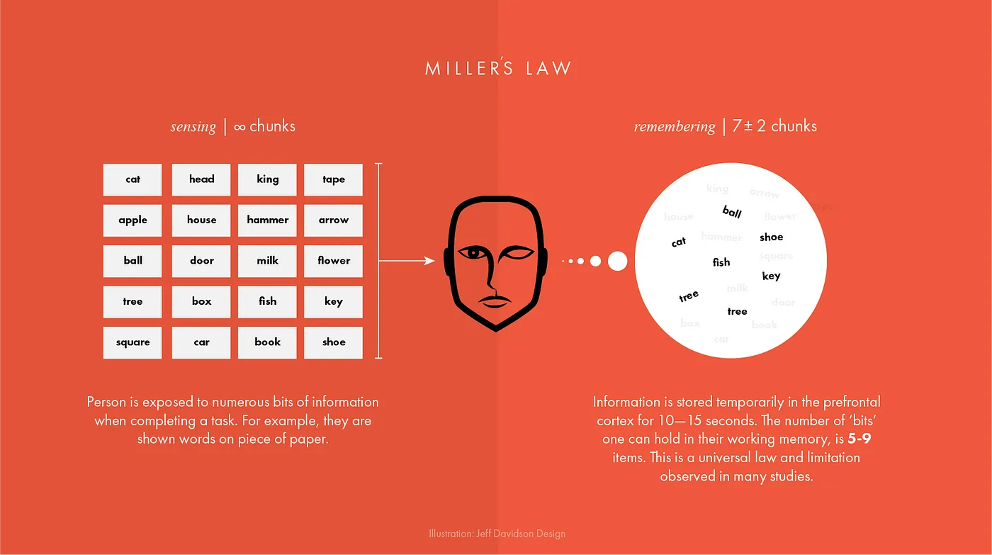
Working Memory – Information Processing
Unique
Tested
Showing the impact of your work by using data visualization
Telling stories through visuals and data
Elephant
Authentic
Creating more memorable information through the use of symbols and icons
Harnessing color to illustrate importance and attract attention
Notes:
The first concept is "chunking" and the capacity of short term memory. Miller (1956) presented the idea that short-term memory could only hold 5-9 chunks of information (seven plus or minus two) where a chunk is any meaningful unit. A chunk could refer to digits, words, chess positions, or people's faces. The concept of chunking and the limited capacity of short term memory became a basic element of all subsequent theories of memory.

Slide 6
George Miller’s Magical Number of Immediate Memory
Unique
Tested
Showing the impact of your work by using data visualization
Telling stories through visuals and data
Elephant
Authentic
Creating more memorable information through the use of symbols and icons
Harnessing color to illustrate importance and attract attention
Notes:
Humans are visually oriented animals with approximately 55% of our cortex is dedicated to processing visual stimuli.
The first concept is "chunking" and the capacity of short term memory. Miller (1956) presented the idea that short-term memory could only hold 5-9 chunks of information (seven plus or minus two) where a chunk is any meaningful unit. A chunk could refer to digits, words, chess positions, or people's faces. The concept of chunking and the limited capacity of short term memory became a basic element of all subsequent theories of memory.

Slide 7

Definition
Visual communication is the practice of using visual elements to get a message across, inspire change, or evoke an emotion.

Slide 8
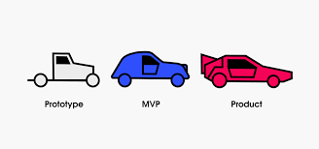
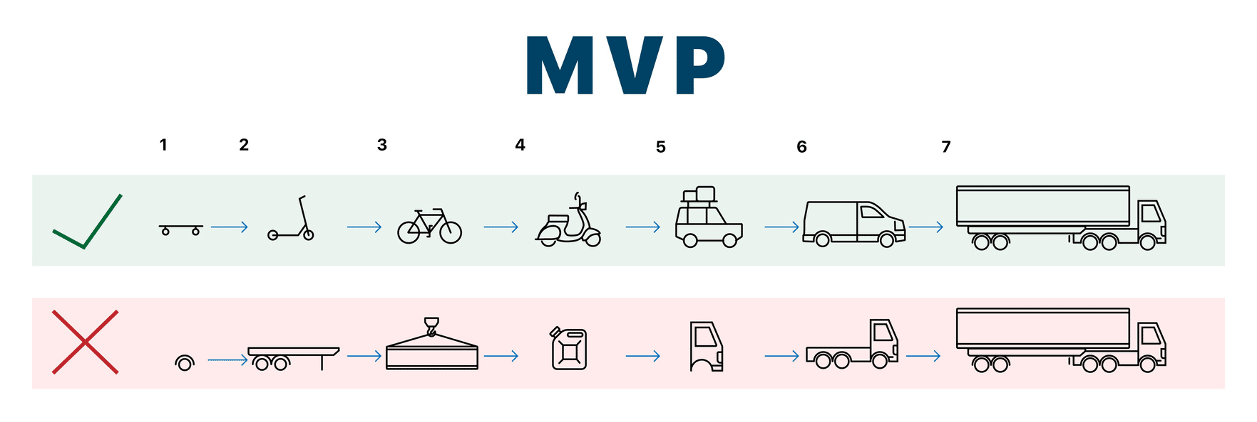
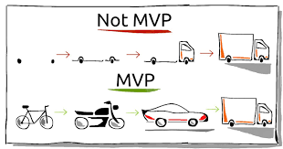
Perfect MVP
Communication design refers to crafting a message that educates, motivates, and engages the viewer.
Graphic design uses design principles to communicate that message in a way that is clear and eye-catching to the intended audience.

Slide 9
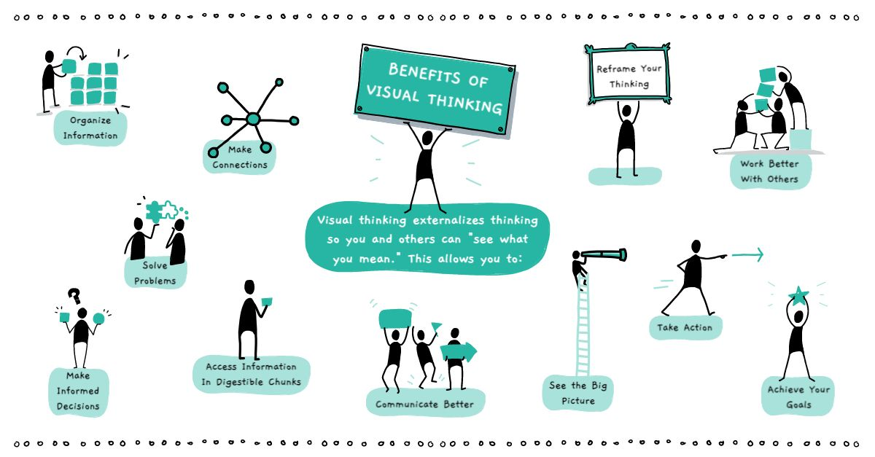
Definition
Visual communication is the practice of using visual elements to get a message across, inspire change, or evoke an emotion.
Source : Drawify

Slide 10

Examples

Slide 11
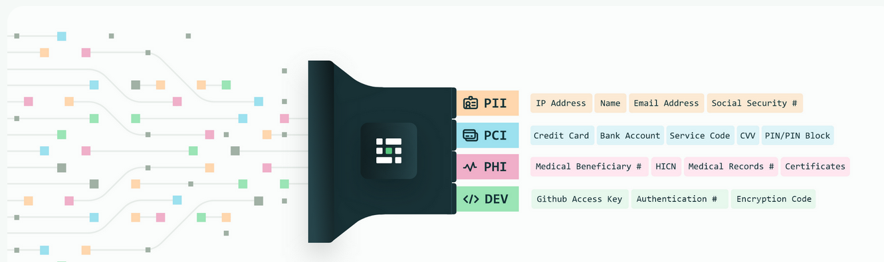
Privacy
Source : Medium blog
Notes:
Personal Identifiable Information (PII) is defined as: Any representation of information that permits the identity of an individual to whom the information applies to be reasonably inferred by either direct or indirect means.

Slide 12
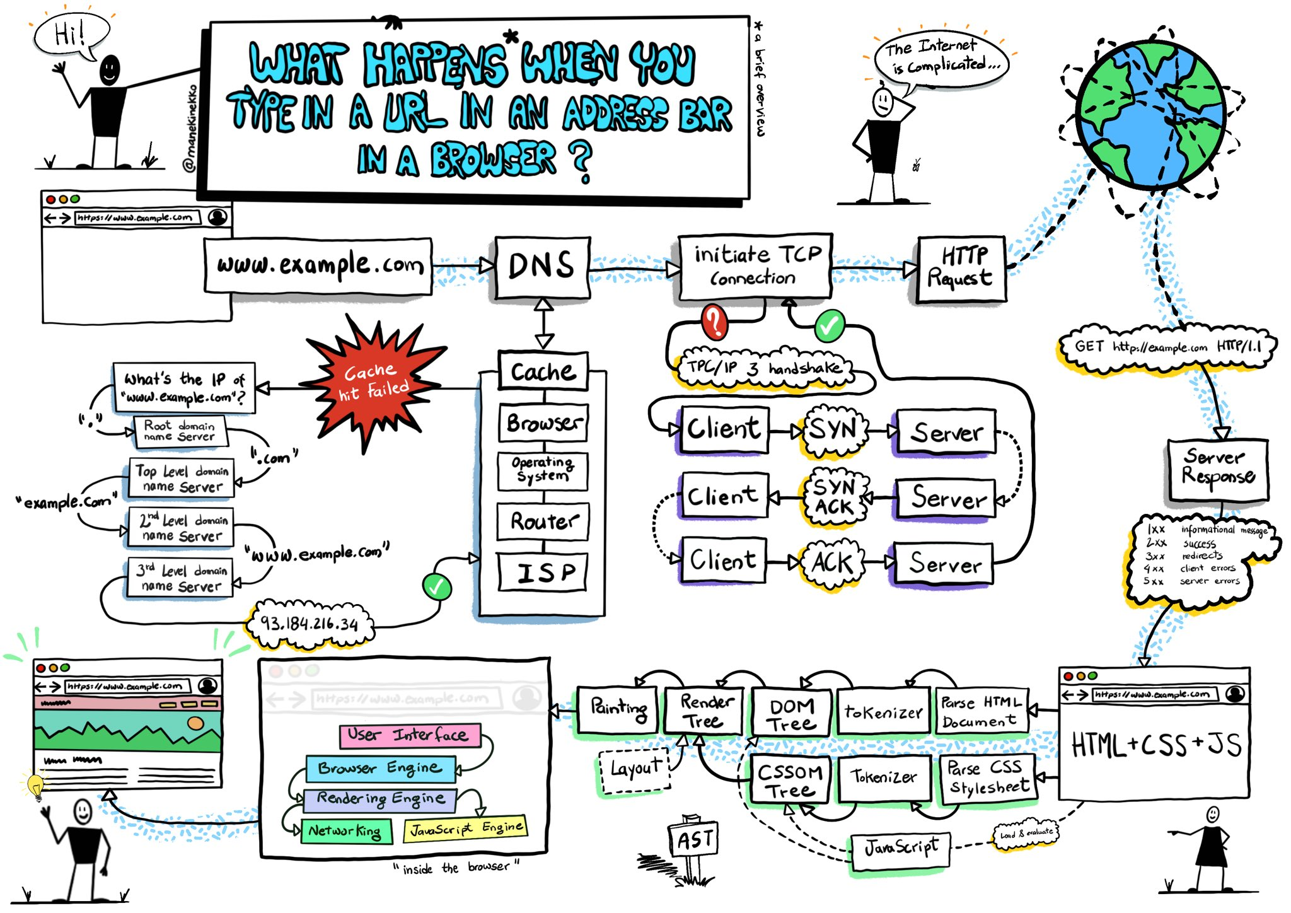
ELI5
Source :Wassim Chegham
Notes:
Personal Identifiable Information (PII) is defined as: Any representation of information that permits the identity of an individual to whom the information applies to be reasonably inferred by either direct or indirect means.

Slide 13
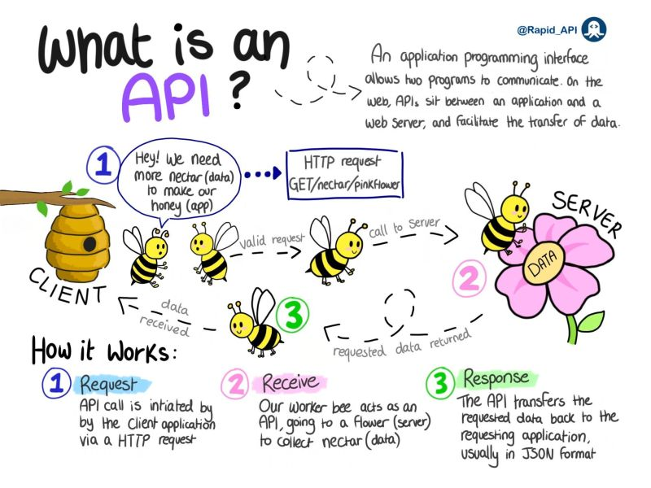
API
Source :
Notes:
Personal Identifiable Information (PII) is defined as: Any representation of information that permits the identity of an individual to whom the information applies to be reasonably inferred by either direct or indirect means.

Slide 14
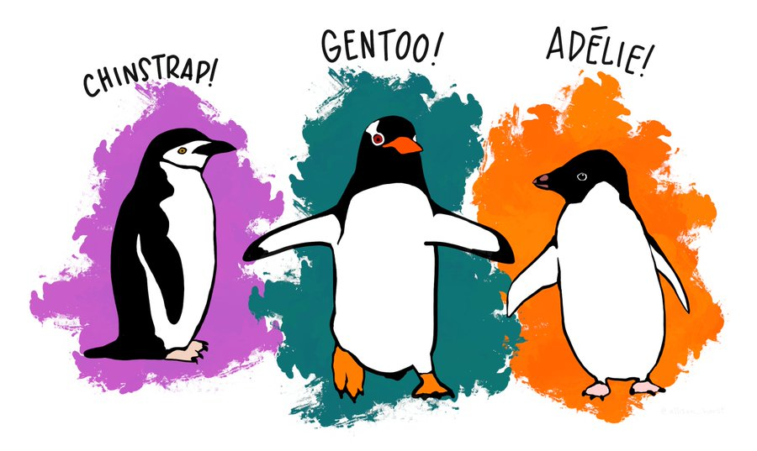
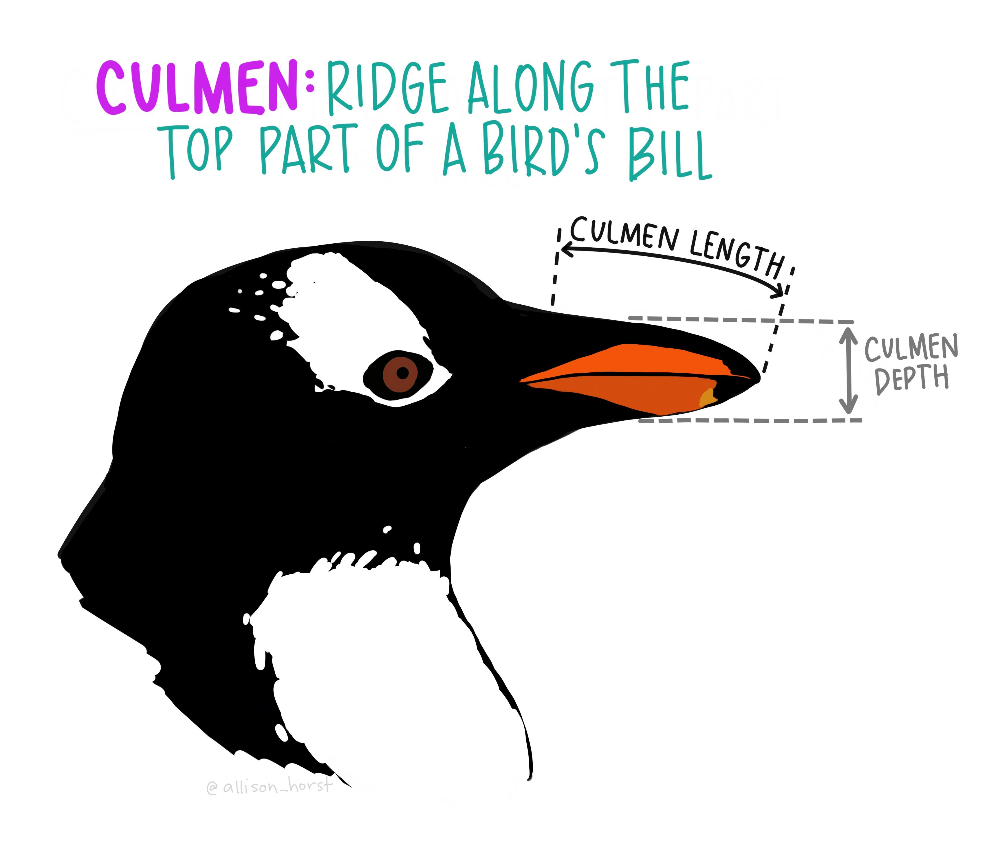
Penguin Dataset
Goal
Determine the species of a penguin
Parameters :
• Culmen length
• Culmen depth
• Flipper length
• Body mass
Source : Twitter

Slide 15
Not this!

Slide 16
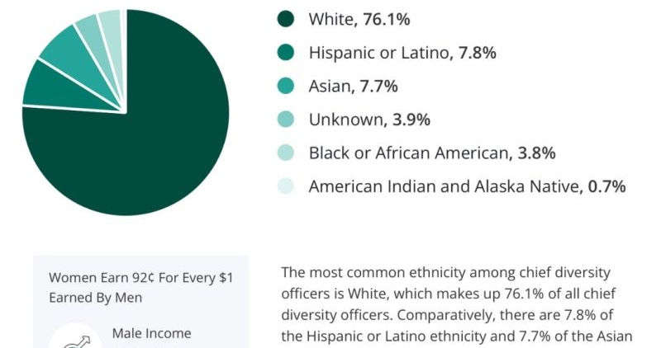
Colors?

Slide 17
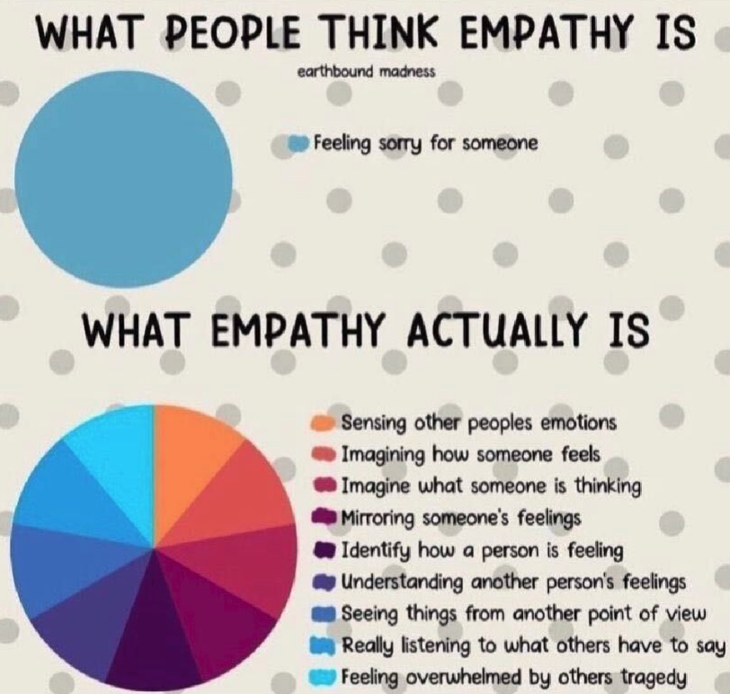

Slide 18
Manual Of Me

Slide 19


Slide 20
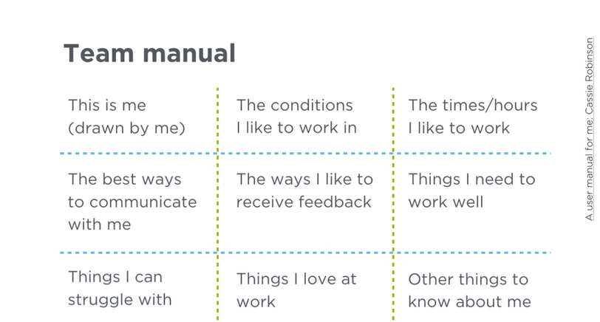

Slide 21
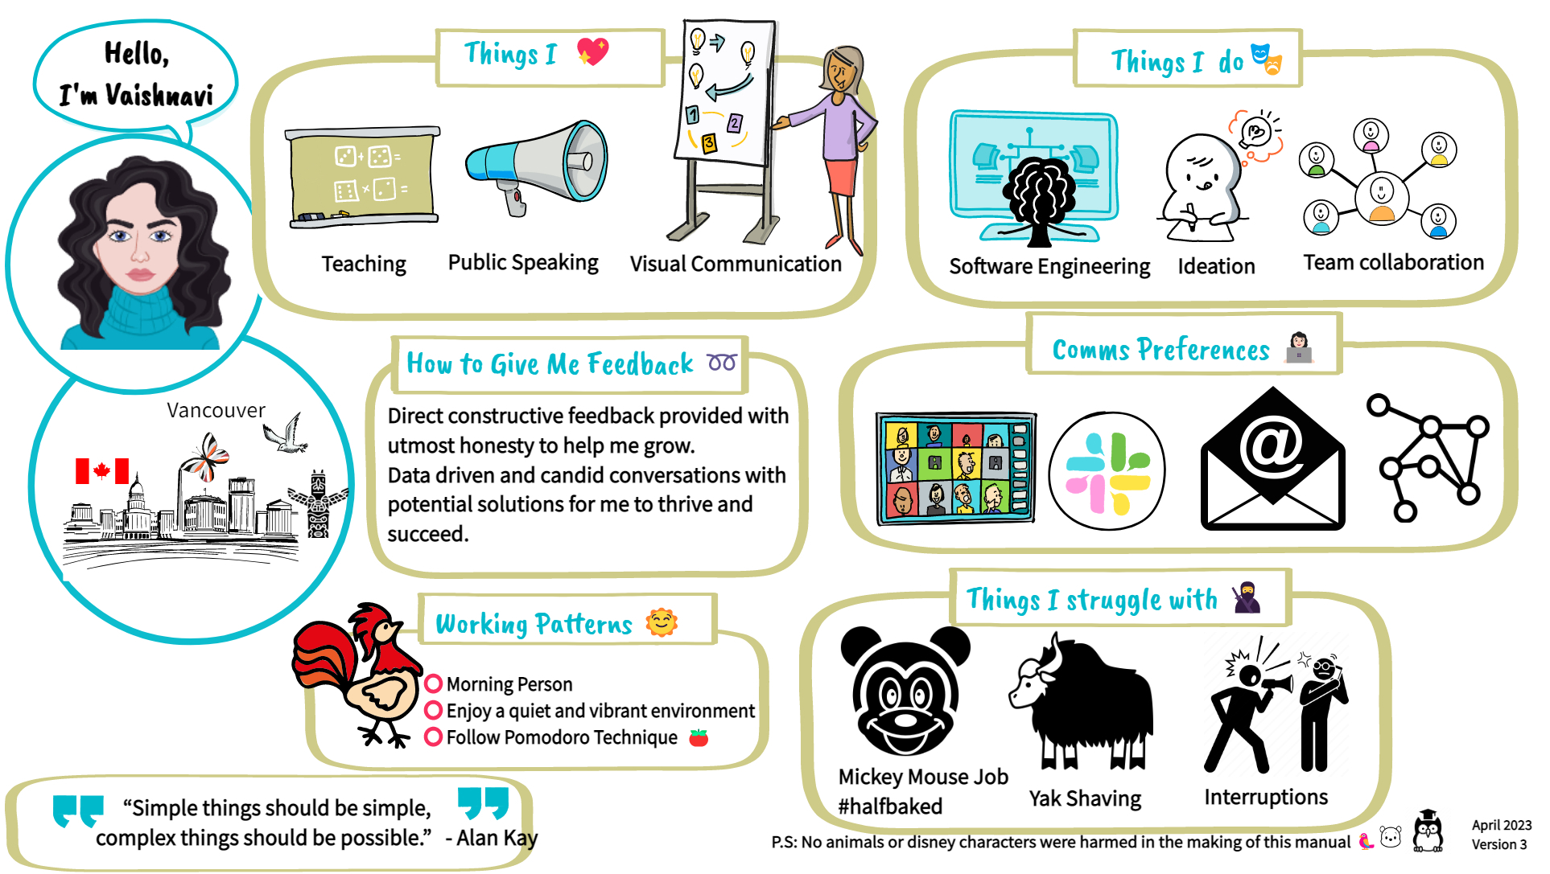

Slide 22
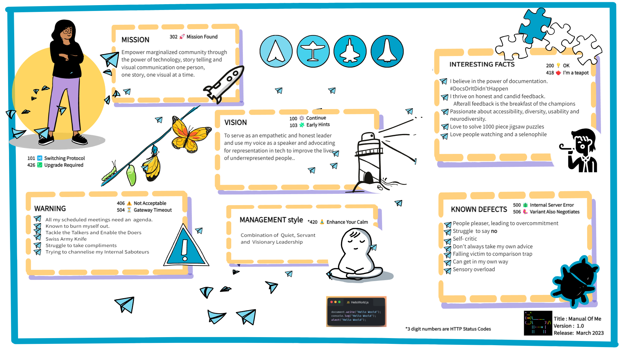
Meet the team

Slide 23
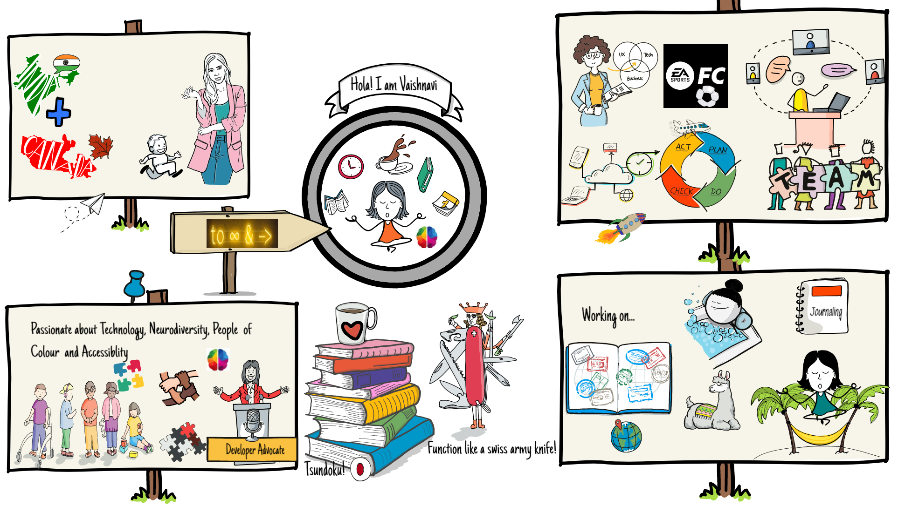
Meet the team

Slide 24
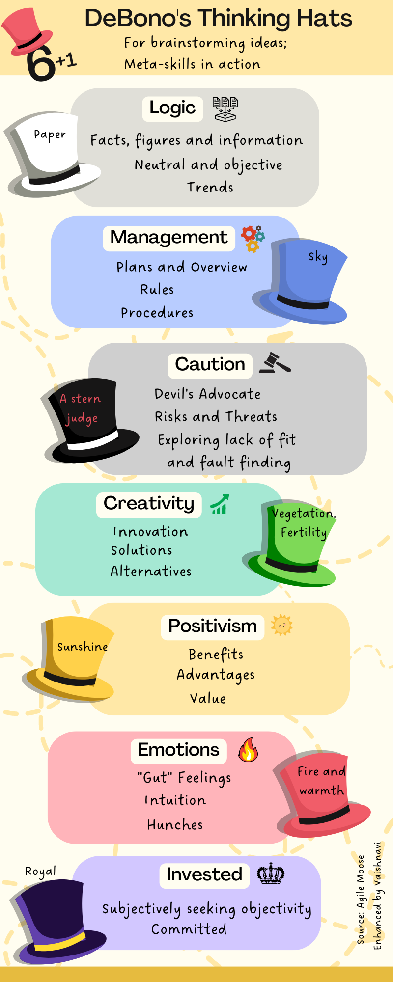

Slide 25
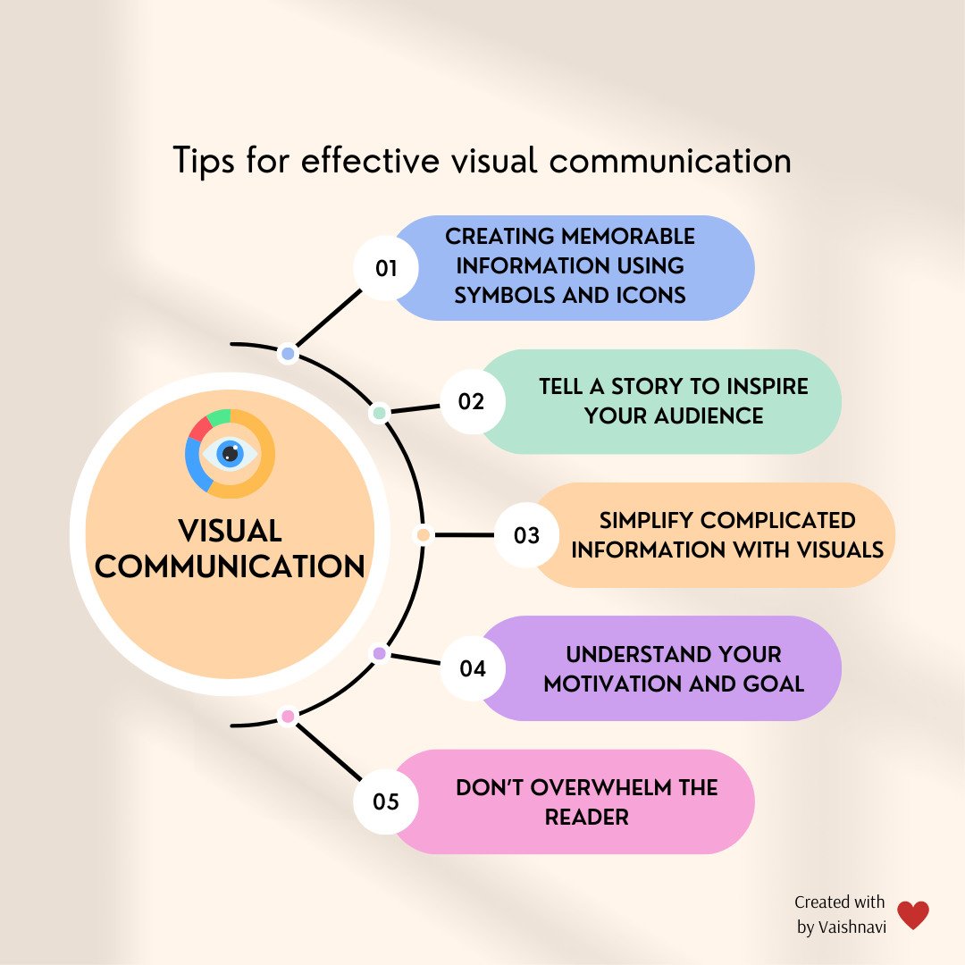

Slide 26
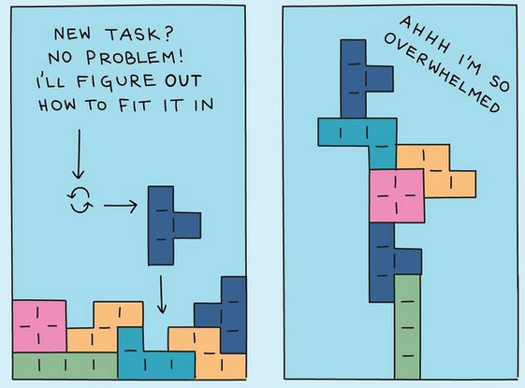
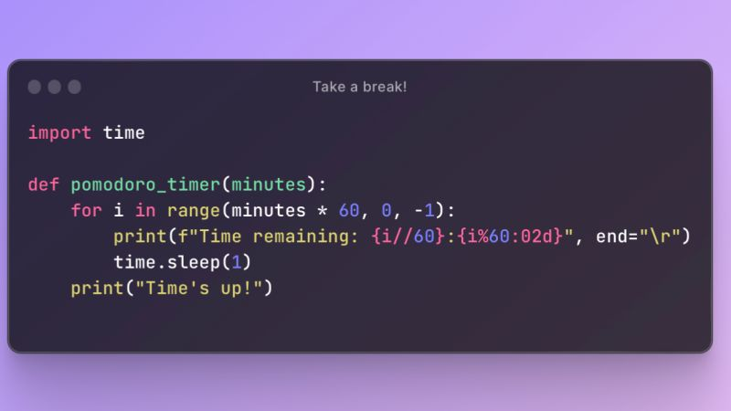

Ideas
$3B
$2B
$ 1B
Opportunity to build
Fully inclusive market
Total addressable market
Freedom to invent
Selectively inclusive market
Serviceable available market
Few competitors
Specifically targeted market
Serviceable obtainable market

Slide 27
Ideas
Software is like entropy: It is difficult to grasp, weighs nothing, and obeys the Second Law of Thermodynamics; i.e., it always increases.
Norman Augustine

Slide 28
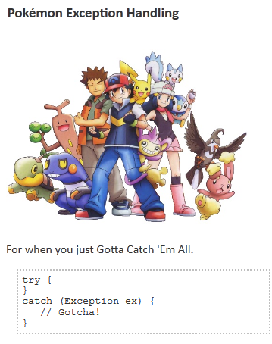

Slide 29


Slide 30


Slide 31

Containerization (Optional)
Think of shipping containers on a boat.
A shipping container is like a Docker container.
A port is a facility that will load/unload, manage, move, inventory, and handle shipping and movement logistics. This is Kubernetes.
Containers are horses and Kubernetes is the Ranch managing those horses.
You decide how many horses in the ranch and the Ranch Manager will make sure to keep that many
horses there at all times. They can also bring other horses from other ranches if one dies to make sure they always have exact amount of horses you specified
Kubernetes automates a lot of the cloud set and forget stuff. How do you have redundancy’s. Tell kubernetes I want 3 of these boom you have three. What’s underneath? Maybe docker. Instead of you doing the scripting docker does it.
Opportunity to build
Fully inclusive market
Total addressable market

Slide 32
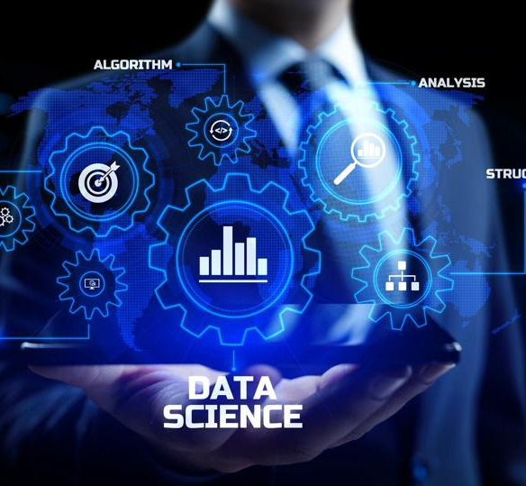
What next?
Convergence
In today's digital world, AI, cloud computing, the internet of things (IoT), and superfast networks such as 5G are the cornerstones, and data is the fuel that drives them all. These technologies are some of the data science latest trends. Together, these technologies enable much more than they can do separately.

Slide 33
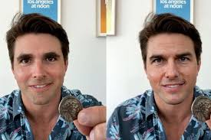
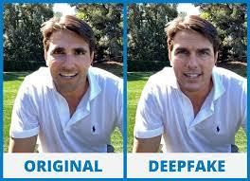
DEEPFAKE TECHNOLOGY: SEEING IS BELIEVING, OR IS IT?
Notes:
fabricate images and videos to the point where you won’t be able to tell what’s real and what’s not.

Slide 34

Deepfakes, Generative AI, and synthetic data – Word of Caution
Double Edged sword
Deepfakes are often weaponized against women. The majority of deepfakes on the internet are pornographic, in which female celebrities' faces are infused into these videos.
Notes:
Software is like entropy: It is difficult to grasp, weighs nothing, and obeys the Second Law of Thermodynamics; i.e., it always increases.
Norman Augustine

Slide 35


Thank you

